Slide 1
Bunkering operation
The Bunker system should have been maintained in good order and all equipment (tank level gauges, alarms) should be in working order.
The bunker lines should have been pressure tested (7 bar) within the past 12 months.
The bunker ordered together with that remaining on board should meet the bunker requirements for the coming voyage + 5 days.
All persons involve in bunkering knows the quantity and specification of fuel to be taken on.
Prepare the Bunker plan and discuss with all concern person.
Arrange any necessary transfer of fuel to allow bunkering to take place into empty tanks.
Record transfer in ORB.
check fuel lines earth bonding.
Check communication equipment between manifold / tank control.
Clean all filters in bunker filling lines.
Ensure those involved in the bunkering operation all fully briefed, and know the position of valve, order of filling emergency operation / procedures.
Ensure overflow tank is empty.
Hoist the bunker flag or red light during bunkering.
The bunker loading plan should be prominently displayed at the manifold connection, the bunker station and E/R office.
Ensure drip trays and scuppers are plugged.
Ensure all SOPEP equipment are ready to use and in hand.
Fire hose (charged) & Foam extinguisher are also placed adjacent to bunker station.
"No Smoking" signs erected and visible.

Slide 2
Barge Operations Procedure
Ensure the barge is safely and tightly moored.
Check with the barge master that the fuel on the barge, according to the delivery sheet, matches the grade and quantity ordered.
The receipt will also detail the location and time of delivery, product temperature, density, and sample seal number.
Check the fuel tanks on the barge before commencing the bunkering and again at the end of the bunkering.
If a meter is fitted on the barge discharge line, record it.
Before the line is connected, a sample should be taken onboard and tested for compatibility.
The pumping rate, maximum delivery pressure, and means of communication will also be agreed upon with the barge master.
Ensure the proper connections (joints, reducers, etc.) of the bunker line.
Ensure the bunker line is set for the first tank(s) to be filled.
When the barge is ready to start pumping, inform all concerned persons and start the bunkering process slowly.
Double-check when pumping commences that there are no leaks around the manifold.
Once everything is in order and fuel is flowing to the correct tank, increase the pumping rate.
Whilst the fuel oil transfer is underway, a responsible person must be stationed at the manifold at all times.
The tanks being filled must be monitored continuously.

Slide 3
As one tank reaches its limit, the next tank to be filled must be prepared.
As the end of bunkering approaches, the pumping rate must be slowed down as the tanks are topped up.
Once bunkers have finished, the filling line may be "blown through" to ensure no oil remains in the line.
Tanks on board are then sounded as are the tanks on the barge.
If the quantity tally then the fuel oil receipt signed by C/E.
The responsible person will be asked to witness the sealing of the sample bottles one of which should be held by ship.
The filling line disconnect and manifold blanks replaced.
The ORB should be filled in with details of the amount bunkered, tanks filled and times.

Slide 4
Bunker sample. When taking bunkers a representative sample of the F.O. delivered should be given to ship by the supplier. The Supplier will often use a flow proportional automatic continuous sampler, will take a sample of the fuel as the fuel is pumped onboard. The C/E or his representative will be asked to witness the setting and sealing of the sampler. At the end of the bunkers, the sample bottles are sealed, again witnessed and signed. One of the bottle retain on board for at least 3 months in case of dispute over the bunker quality. Ship is also taking its own sample. The most practical and economical method of doing this is to employ Continuous drip sampler.

Slide 5
(a) Discuss the problems that may result from the use, storage, and handling of modern residual fuel of low quality. (b) State on-board tests available for assessment of fuel quality.
(a) The ignition quality of a fuel dictates the time delay which occurs between injection and ignition of the fuel in a cylinder. Low-quality fuel has a shorter delay between injection and ignition. The rate of pressure rise within the cylinder will be lower than normal, producing a lower peak pressure.
Low-quality fuel will contain ash, catalyst fines, harmful impurities, which can disturb the operation of purifiers, filter choking. Regular cleaning of filters and purifier bowl assembly is required.
More wear-down in liner/piston rings, hot corrosion on piston crown and exhaust valves, cold corrosion of liner, turbine inlet mesh will choke frequently and need cleaning. Wear-down in fuel pump plunger/barrel assembly.

Slide 6
(b) Testing of Fuel Oil
Spot Test: Take a drop of oil on chromatographic paper and analyze the sample.
Water Test: A sample of the fuel (5 ml) is diluted with kerosene (20 ml) and placed in a container. A sachet of a metal hydride is opened and placed upright in the container without allowing the chemical to come into contact with the fuel. A lid containing a pressure gauge is screwed on carefully, and the container is inverted and shaken for 2 min. The water in the fuel reacts with the metal hydride, producing hydrogen. The pressure in the container is proportional to the water content.
Viscosity: Onboard testing of viscosity usually involves rolling a ball down a tilted or inverted tube, which contains a sample of fuel at 50°C. The time the ball takes to roll down the tube is measured, and the result is read directly from the instrument.
Density: A sample of the fuel is heated to 50°C, and a hydrometer is lowered into the oil. When a steady condition has been reached, a reading is taken where the meniscus touches the hydrometer stem.

Slide 7
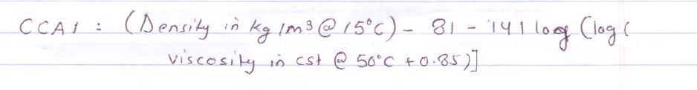
Pour Point: A sample of 200 ml of fuel oil is placed in a beaker of 250 ml and heated by immersing the beaker in a hot bath of boiling water. It may be necessary to hold the fuel in the beaker while the fuel is heated to about 50°C. The beaker is then placed in the refrigerator, and the temperature noted. At increments of 3°C, the beaker should be removed, and the content tilted to see if they flow. This should be repeated until no flow is observed.
Closed flash point: In the Pensky-Martens apparatus, approximately 75 ml of sample is heated at a slow constant rate with continual stirring. A small flame is then directed through an opening at regular intervals with simultaneous interruption of the stirring. The flash point is the lowest temperature at which application of the test flame causes the vapours to ignite.

Slide 8
(a) Discuss the means by which water may enter a forward double bottom oil fuel tank of a ship at sea.
(a) Water can enter the forward double bottom tank of a ship by the following reasons:
Leakage in the heating coil. That can be investigated in the return line/observation tank.
Air vent - if the NR (Non-Return) ball valve is not working properly, then during heavy sea water can enter in the DB tank.
Open sounding cap - human error.
Shell plating of a fuel oil DB tank cracked/holed/ruptured.
(b) The shell plating of a fuel oil DB tank containing oil is ruptured. State the actions to be taken if:
(i) The oil is required for use at sea:
Very frequent draining of settling/service tank.
Purifier throughput to reduce and maintain at high performance.
Gravity disc size to be correct according to the manual.
F.O. drains not to be transferred back to the fuel oil system (Tanks).
E/R will be manned at all times.
Once the service fuel operates purifiers, set to settling tank 70T, full gain change to settle service tank.

Slide 9
(ii) The ship is shortly to enter drydock:
Class notified.
Transfer oil to other tanks and prepare the tank for inspection.
Check the extent of damage from other side and forward to office and drydock along with docking specifications.
(a) Describe, with the aid of a sketch, an apparatus for determining the flashpoint.
(b) State why the closed flashpoint is specific rather than the open flashpoint.
(c) State the health hazards of fuel oil testing.
(a) "In the Pensky-Martens apparatus, approximately 75 ml of sample is heated at a slow constant rate with continuous stirring. A small flame is then directed through an opening at regular intervals with simultaneous interruption of the stirring. The temperature at which the flash occurs for the first time is the closed flashpoint of the oil being tested."
Flashpoint below 22°C → highly flammable and dangerous. Above 66°C → safe for marine use.

Slide 10
(b) Onboard ship fuel is stored in closed tanks, so the closed flashpoint is specific for storage rather than the open flashpoint.
(c)
Inhalation of fuel oil vapor → Hydrocarbon exposure.
Skin contact with fuel → Sulphur compounds can cause cancer.
Eye contact with fuel.
Fuel oil testing involves chemicals.
List the principle undesirable impurities found in L.0. Deposits of the product of incomplete combustion. Wear debries, dust and oxidation products. Cu - Bearing, oil coolers, pipework Pb, Sn - Bearing Al - Gears, fuels Fe - Piston, cylinder Mo, Cr - Piston rings Va, Na - fuel Water leakages in the system.

Slide 11
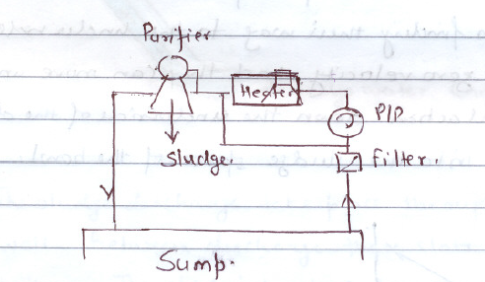
Describe with the aid of a block diagram, how the separator is connected into the system.
L.O. purifier for diesel engine plant are normally arranged as continuous bypass system. Oil is drawn from the sump by purifier supply pump via a filter, delivered through a heater to purifier and then discharge back to sump after purification.

Slide 12

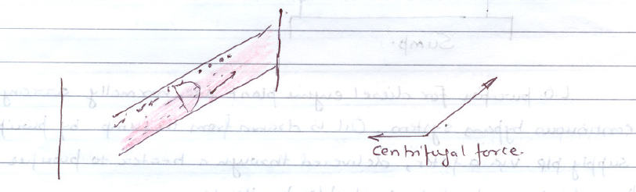
Explain the dynamics of a particles undergoing separation in the centrifuge disc stack.
If an oil flows in a stream line condition between two parallel plate, its velocity varies between zero where it is in contact with the plate to a maximum at the centre between the plate.
Oil flow between two discs in a centrifuge is radially inward and up towards the clean oil outlet. Any particles in the oil will follow this general flow but will also be acted upon by radially outward centrifugal force. The magnitude of this force depends upon the mass of the particles, Any particles finding their way to the underside of a disc entire a region of zero velocity and they can move under the force of centrifugal action down the underside of the disc and eventually into the sludge space of the bowl.

Slide 13
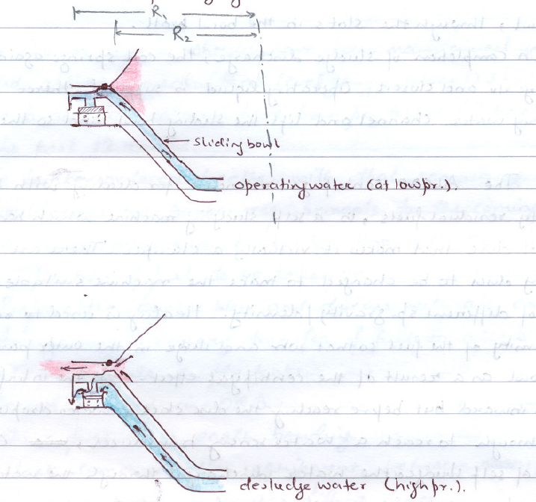
Sketch the self-desludging mechanism

Slide 14
The sludge discharge takes place through a number of slots in the bowl wall. Between discharges, these slots are closed by the sliding bowl bottom. The sliding bowl is forced upwards against a seal ring by the pressure of the operating liquid contained in the space below it.
This exceeds the counteracting downward pressure from the oil, because the underside of the sliding bottom has a larger pressure surface (R₁) than its upper side (R₂). Operating liquid is supplied on the underside of the bowl via a paring disc.
When the sludge is to be discharged, desluging water supplied in the desludging (higher pressure) channel discharges via an open liquid pressure, and operating water flows out. When the pressure exerted by the operating liquid against the underside of the sliding bowl diminishes, the latter is forced downwards and opens, so that sludge is ejected from the bowl, through the slots in the bowl wall.
On completion of sludge discharge, the coil springs again force the discharge valve and close it. Operating liquid is supplied in the operating water channel and lifts the sliding bowl, and so the bowl is closed.
The ALCAP centrifuge, intended for cleaning with high-density residual fuels, is a self-sludging machine that has a flow control disc that makes it virtually a clarifier. There are no gravity discs to be changed to make the machine suitable for fuels of different specific gravity or density. Heating is used to reduce the density of the fuel so that water and sludge in the outer part of the bowl are a result of the centrifugal effect. As the interface moves inward but before reaching the disc stack, water droplets flow through to reach a water-sensing transducer, causing a bowl of self-sludge or the water discharged through the water drain.
At regular intervals, a sludge cycle will take place, water is admitted into the bowl and softens the sludge and displaces the oil in the bowl. When a transducer in the oil discharge line detects water, the bowl opens, and sludge along with water discharges. The bowl opens/closes very rapidly, and oil loss is minimal. If the fuel contains water, it builds up in the bowl and starts to be discharged with the clean oil. The transducer in the oil discharge line will detect this, then the water discharge valve opens.

